Slide 1



INTRO TO
DATA WAREHOUSE
ARCHITECTURE
Presented by:
Md Fazlul Haque
Lead Data Engineer

Slide 2

OVERVIEW
01
02
03
04
Story of Data Warehouse
Challenges and solutions
CDC and It's Challenges
Logical Architecture
05
06
07
08
Current and Future Tools
Planned Architecture
Performance Comparison
Cost Comparison
09
Migration Plan

Slide 3

STORY OF DATA WAREHOUSE

Slide 4





STATS OF ERP DB
Database Size: 10TB+
Number of Tables: 2500+
TPS: 3500+

Slide 5






Why a Dedicated Data Warehouse is Essential
Resource Intensive Processing
With massive transaction volumes and table sizes reaching several hundred GBs, running reports on the live ERP database during office hours becomes highly resource-intensive
Report Frequency
Not all reports are end-of-day; clients need real-time or close real-time insights during office hours. Serving these reports directly from the live database is inefficient
Importance of Fact and Dimension Tables
To optimize query performance and simplify complex analysis, we needed well-structured fact tables and, in some cases, consolidated facts and dimensions for more efficient data retrieval

Slide 6









CURRENT DATA ARCHITECTURE
Data Pipeline Stack
Orchestration
Airflow
User Interface
EDB 15 (ERP)
Computer Engine
Data Integration
Data Warehouse
Reports & Share Business Analysis
Data Transformation Tool
Data Mart
DBT

Slide 7











Requirements Gathering
Data Validation and Testing
Identify data sources
Understand data consumers
Data integrity checks
End-to-end testing
Monitoring and Logging
Data Ingestion
Select tools and protocols
Batch vs. streaming
Set up alerts
Implement logging
Data Pipeline
Transformation and Cleaning
Automation and Data Spike Control
Data quality checks
Schema mapping
Transform data
Automate pipeline runs
Mechanism in place for sudden data spike
Documentation and Optimization
Data Storage
Choose a storage solution
Partitioning and indexing
Document pipeline
Optimize and iterate

Slide 8

01. ORCHESTRATION
01. DATA CLEANING
Orchestration coordinates and manages task execution and dependencies, ensuring they run in the correct order.
Removing inaccuracies, duplicates, and inconsistencies to improve data quality
02. END-TO-END PIPELINE AUTOMATION
02.TRANSFORM
01
01
Converting data into the desired format, structure, or schema
Ensures seamless data flow from ingestion to storage, transformation, and output.
02
02
Data Workflow
vs
Data Processing
03. SCHEDULING
03. COMPUTE
Scheduling is the process of running specific tasks at predefined times or intervals
03
03
Summarizing, calculating metrics, and performing complex calculations on data
04
04
04. ERROR HANDLING AND RETRY LOGIC
04. VALIDATION
Controls failure scenarios to maintain pipeline health
Ensuring data meets defined standards and is ready for analysis or reporting

Slide 9







DATA PIPELINE
ETL
VS
ELT
Before loading to the target system
After loading to the target system
Stores only transformed data
Stores both raw and transformed data
External transformation engine
Uses the power of the target system
Data warehouses with limited processing power
Data warehouses with vast processing power

Slide 10
Evolution of Our Pipeline Process

Slide 11
TIME FOR AN ANALOGY!
Imagine an orchestra where each musician plays a different instrument, from violins and cellos to trumpets and drums.
The conductor’s role is to lead the musicians, setting the tempo, cueing different sections, and ensuring each part of the symphony flows smoothly.
The conductor doesn’t play the instruments themselves. instead, they focus on timing and coordination, making sure each musician comes in at precisely the right moment.

Slide 12

CHOOSING OUR ETL TOOL
In evaluating various ETL tools, we prioritized these key attributes:
Modularity and Task Dependency Management
Scalability and Distributed Execution
Community Support and Ecosystem Integration
Comprehensive Logging, Monitoring, and Alerting
Our goal: finding a tool that enhances workflow management, scales seamlessly, and provides strong monitoring capabilities.

Slide 13



WHY APACHE AIRFLOW
ORCHESTRATION FOCUSED
OPEN SOURCE
EASY INTEGRATION
Built as an orchestration platform, Airflow is designed to manage and schedule complex workflows that can span multiple systems, which is ideal for data engineering pipeline
Built as an orchestration platform, Airflow is designed to manage and schedule complex workflows that can span multiple systems, which is ideal for data engineering pipeline
Built as an orchestration platform, Airflow is designed to manage and schedule complex workflows that can span multiple systems, which is ideal for data engineering pipeline

Slide 14





AIRFLOW MAJOR COMPONENTS
Scheduler
Web Server
Workers
Executor
Metadata Database

Slide 15


DIFFICULTIES WE ADDRESSED
Combine data hosted on different servers
Some temporary tables depend on others:
- For example, temporary table A may be used to further refine data for temporary table B.
Our source is a read-only ERP database replica.
This ERP replica is hosted on a different server from our data warehouse.
Solution: We leveraged Apache Parquet to store these temporary tables in a shared storage location, allowing us to efficiently read and process the datasets using Pandas.
Unexpected data surge
Processing data for all offices across all business dates for the past two months can create challenges.
Our data integration tasks run in parallel.
Triggering tasks for every office and business date simultaneously places a heavy load on:
- The source server
- The Airflow server
- The destination server
Solution: We implemented Pools in Airflow. Pools allow us to control the parallel execution of tasks by limiting the number of resources consumed, effectively managing system load.

Slide 16
Data integration

Slide 17



Methods of
CHANGE DATA CAPTURE
Log Based
Monitors database transaction logs to detect data changes
01
Query Based
Periodically queries the source database for changes based on timestamps or other markers
02
Trigger Based
Uses database triggers to capture changes (inserts, updates, deletes) in real time by writing them to a change table
03

Slide 18


CHALLENGES IN IMPLEMENTING CDC
Schema Change Detection
Unreliable History Column

Slide 19





INTRO TO
Airbyte is an open-source data integration tool designed to extract data from various sources (e.g., APIs, databases) and load it into destinations like data warehouses, lakes, or other databases.
Connector Library
Schema Change Detection
Retry Feature and Logging
Offers pre-built connectors for hundreds of sources and destinations
Automatically identifies changes in source schemas, such as added, removed, or modified fields, during data syncs
Ensure data sync reliability and transparency

Slide 20
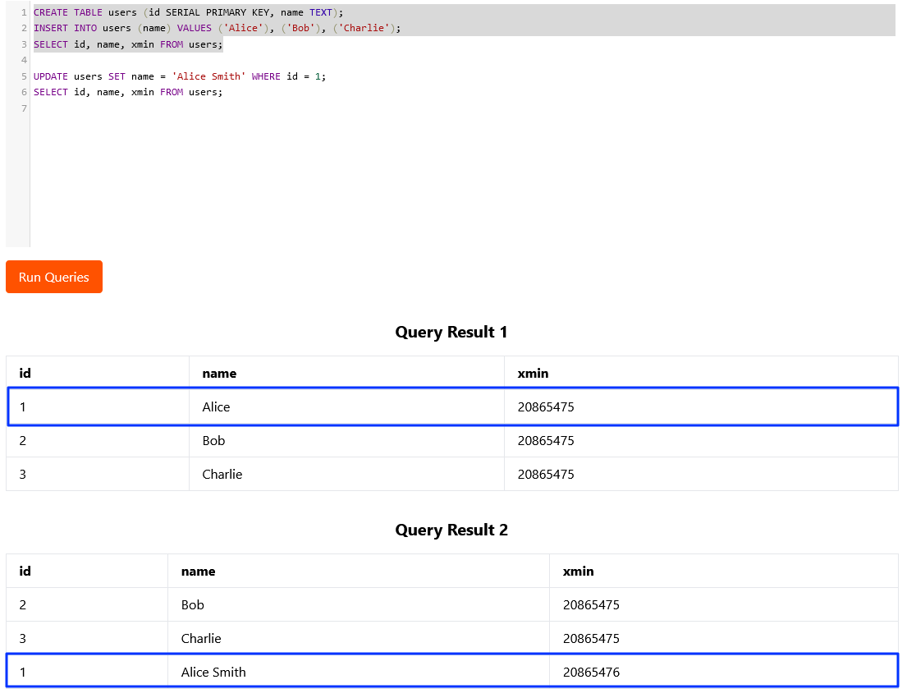
XMIN FOR CDC

Slide 21
Data Transformation

Slide 22
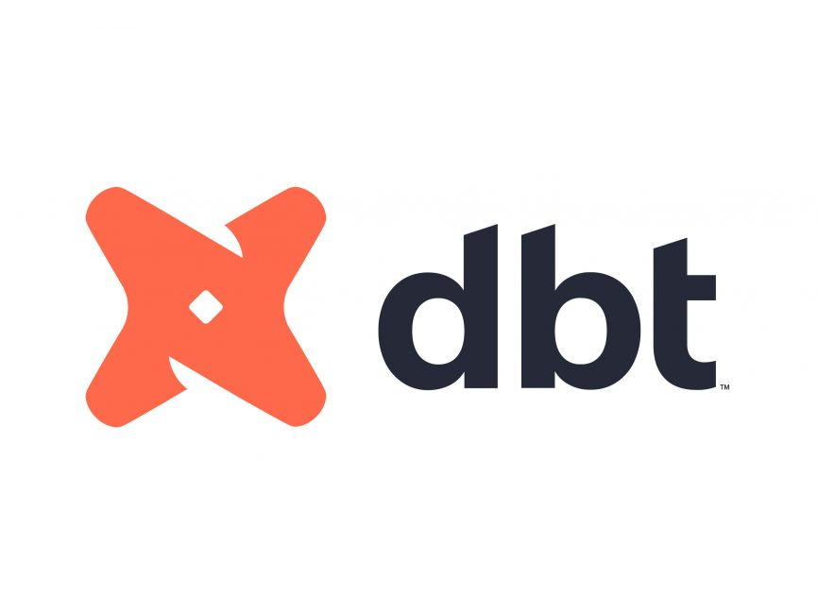



INTRO TO
dbt (data build tool) is an open-source command-line tool that enables data analysts and engineers to transform and model data within their data warehouses.
Modular Models
Version Control
Testing and Documentation
Supports the creation of modular SQL models that can be combined and reused, promoting code reusability and maintainability
Integrates with Git for version control, allowing teams to collaborate on data models and track changes over time
Provides built-in testing capabilities to ensure data quality and automatically generates documentation for data models

Slide 23
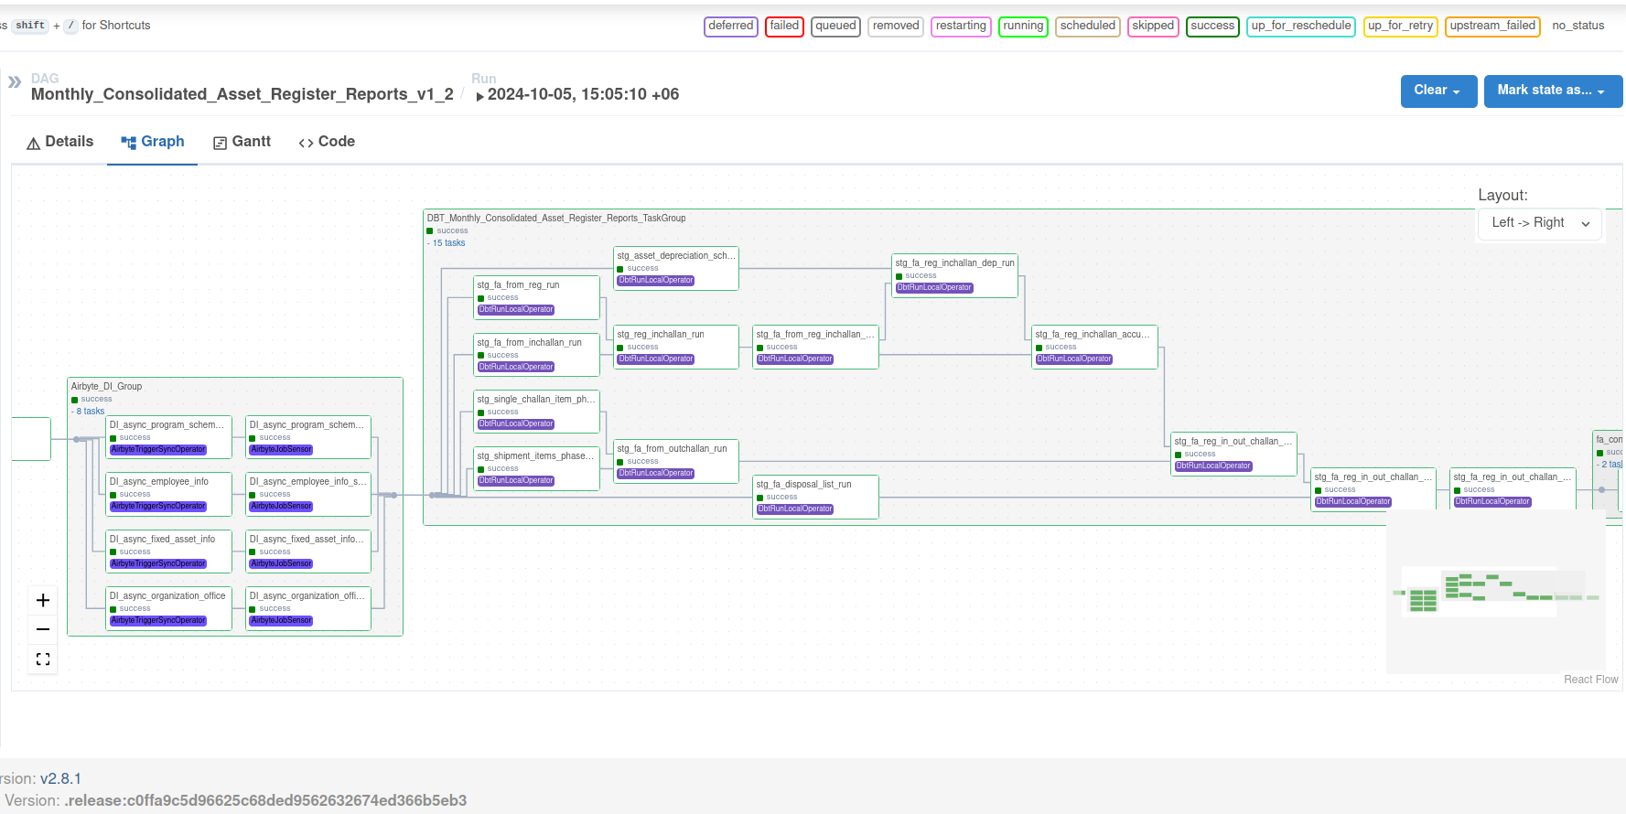
LIVE DEMO

Slide 24











LOGICAL DATA ARCHITECTURE
Orchestration Layer
Brac Microfinance
Data Lake
Data Warehouse
Power BI
Centralized Repository
Batch
Store structured data
Brac Education
Unstructured data
Semi-structured data
Structured data
Dashboard
Brac Health
Stream
Facts Tables
Dimension Tables
Data Process
API
UPG
Centralized ETL
Mapping Tables
CDC
Reporting tools
MF Analytics
Finance Data Mart
MRA Mart
MI Portal
HR Analytics
Education
Health
Data Mart
App
Other Programs
Batch Process
Stream Process
Data Sources
Data Transmission
Data Processing
Data Storage
Analytics

Slide 25








PLANNED DATA ARCHITECTURE
Third Party managed Service
Optional
Fivetran
Optional
Optional
Google Self-Managed
Google Managed Service
Data Pipeline Stack
Orchestration
Core
Airflow
Data Processing BigQuery
Data Marts High Availability Cloud SQL
Reports & Share Business Analysis
EDB 15 (ERP)
Computer Engine
Data Integration
On-Premises Database
Data Transformation Tool
Optional - Streaming and Unstructured Data
Cloud Apps
Computer Engine
DBT
File Upload UI
Streaming & File Processing Dataflow
Apache Kafka Computer Engine
Data Lake Cloud Storage

Slide 26
DATA INTEGRATION PERFORMANCE
TABLE NAME
BIGQUERY USING AIRBYTE
POSTGRESQL USING AIRFLOW
FULL LOAN ACCOUNT TRANSACTION | TIME: 48H 43M 24S RECORDS: 2 BILLION 82 MILLION PLUS | Manual Backup and Restore
INCREMENTAL LOAN ACCOUNT TRANSACTION | TIME: 40-50 MIN RECORDS: 4 MILLION 2 HUNDRED 66 THOUSAND PLUS | TIME: 3-5 HOURS RECORDS: AVERAGE 2 MILLION PLUS
LOAN ACCOUNT | TIME: 6H 4M 12S RECORDS: 44 MILLION 6 HUNDRED 37 THOUSAND PLUS | TIME: 8 HOURS 23 MIN RECORDS: 44 MILLION MILLION PLUS

Slide 27


PERFORMANCE COMPARE
Loan Snapshot Prepare Time for 6 months Worth of Data
(1 hundred 80 million Plus records)
22 HOURS
EDB POSTGRESQL 15
1 MIN 46 SEC
BIGQUERY

Slide 28
COST COMPARE
Comparing cost of current data warehouse vs BigQuery for 10 days
CURRENT POSTGRESQL DW CONFIG
CPU: 48 cores
RAM: 256 GB
Boot Disk: 100GB
Archive Log Disk: 3 TB
Data Disk: 11 TB
BIGQUERY + CLOUD STORAGE + CLOUDSQL
Bigquery is serverless
Cloud Storage (serverless) was used for staging area
CloudSQL(PostgreSQL) as Data Mart (vCPUs: 2, RAM: 7.5 GiB)

Slide 29
Migration Plan
Serial | Project Name
1 | Monthly Consolidated Asset Register Reports
2 | Special Savings Consolidated Report
3 | Risk Analysis
4 | MI Portal Dashboard & MI Portal Analytics
5 | Fixed Asset Report
6 | Management Report
7 | ISBS
8 | MRA
9 | Agami Dashboard
10 | Budget
11 | Livestock
12 | Reporting Tool

Slide 30
Thank You

